Slide 1
On multiplier modules of Hilbert C*-modules
Michael Frank
New York 2025, NYC Noncommutative Geometry Seminar
Online, April 2nd, 2025

Slide 2
On multiplier modules of Hilbert C*-modules
There are at least two approaches to a theory of multiplier modules of Hilbert C*-modules.
I would like to stay with the approach by Damir Bakić and Boris Guljaš (2003) in [5,6] which focusses on
a given C*-algebra A and on a given full Hilbert
A-module {X, <.,.>} where the A-valued inner product <.,.> on X is considered within its class of unitary equivalence.
This allows to rely on the notions of "compact" and adjointable operators without reference to possibly existing not unitary equivalent inner products on X inducing equivalent norms. K_{A}(X) becomes unique.

Slide 3
On multiplier modules of Hilbert C*-modules
Noticed by Bartosz Kwasniewski I became aware of the double-centralizer based definition of multiplier modules initiated by Matthew Daws in [D1,D2] (2010) and considered in depth by Alcides Buss, Bartosz Kwasniewski, Andrew McKee and Adam Skalski in [BKMS] (2024). Cf. [EchRae, Delfín] for representations.
They work with Banach A-B bimodules X connecting two given C*-algebras A and B as *-correspondences, specializing finally on imprimitivity bimodules (or: Hilbert A-B bimodules) in the style of strong Morita equivalence of C*-algebras.
C*-valued inner products appear late in the considerations.

Slide 4
On multiplier modules of Hilbert C*-modules
Theorem:
[Lance, Thm.], [Blecher, Thms. 3.1, 3.2], [Frank, Thm. 5], [Solel, Thm. 1.1]
Let A be a C*algebra and X be a left Banach A-module the norm of which is known to be generated by an A-valued inner product on X with unknown values.
Then this A-valued inner product <.,.> on X is unique, and the values can be recovered by the formulae
<x,x> := sup {r(x)*r(x) : r in Xʹ with ||r||≤ 1}
<x,y> := ¼ . Σ_{k=1..4} i^{k .} <x+i^{k}y, x+i^{k}y>
for every x,y in X , where the right side uses the norm of the underlying Banach A-module only.

Slide 5
On multiplier modules of Hilbert C*-modules
Consequences:
Every bijective isometric A-linear isomorphism of two Hilbert A-modules T identifies the two A-valued inner products by the formula
<.,.>₂ = <T(.), T(.)>₁, T*=T⁻¹ if onto, and vice versa.
[Solel, Thm. 3.3]
The Linking C*-algebras of two isometrically isomorphic Hilbert A-modules are *-isomorphic.
The completely boundedness structures on isometrically isomorphic Hilbert A-modules are the same, derived from the A-valued inner product (values).

Slide 6
Settings …

Slide 7
On multiplier modules of Hilbert C*-modules
C*-algebras:
Norm-closed *-subalgebras of W*-algebras B(H) of all bounded linear operators on Hilbert spaces H .
W*-algebras or von Neumann algebras:
Norm-closed *-subalgebras of W*-algebras B(H) of all bounded linear operators on Hilbert spaces H which coincide with their bicommutant.
We focus on non-unital C*-algebras A to get meaningful derived constructions …
… and on C*-algebras where they are two-sided ideals.

Slide 8
On multiplier modules of Hilbert C*-modules
C*-algebras
Considering C*-algebras (and Hilbert C*-modules) there are some points to respect:
Possible existence of non-zero zero-divisors
Possible non-commutativity of multiplication
Inner one-/two-sided norm-closed ideal structure
Possible existence of non-trivial orthogonal and skew projections
… a rich algebraic, topological, noncommutative theory with more derived structures …

Slide 9
On multiplier modules of Hilbert C*-modules
Hilbert C*-modules (full – most offen today)
Let A be a C*-algebra and X be a complex-linear space and (right) A-module where both the complex-linear structures are compatible.
Let X admit a map <.,.>: XX → A conjugate-A-linear in the first and A-linear in the second variable such that
<x,y> = <y,x>* for any x,y in M,
0 ≤ <x,x> for any x in M,
<x,x> = 0 iff x=0.
Then ||x|| := ||<x,x>||_{A}^{1/2} defines an A-module norm on X.
Examples .

Slide 10
On multiplier modules of Hilbert C*-modules
Hilbert C*-modules
A Hilbert C*-module X over a C*-algebra A is said to be full iff A is the norm-closed linear span of the set { <x,y> : x,y in X } . We write A=<X,X> .
Two A-valued inner products on X are unitarily equivalent iff there exists a bounded adjointable invertible module operator T on X such that
<x,y>₂=<T(x),T(y)>₁ for any x,y in X.

Slide 11
On multiplier modules of Hilbert C*-modules
Multipliers of C*-algebras
A - a (non-unital) C*-algebra, faithfully *-represented on H
M(A) = {m in B(H): ma, am in A for any a in A}
- a unital C*-algebra where A is a two-sided norm-closed ideal (the multiplier algebra of A)
LM(A) = RM(A)* = {m in B(H) : ma in A for any a in A}
- a unital Banach algebra (the left/right multiplier algebra)
QM(A) = {m in B(H) : bma in A for any a,b in A}
- an involutive Banach space (the quasi-multiplier space)

Slide 12
On multiplier modules of Hilbert C*-modules
Multiplier algebras
Universal property of M(A):
For any C*-algebra D containing A as a two-sided ideal, there exists a unique *-homomorphism φ: D → M(A) such that φ extends the identity homomorphism on A and φ(A⊥) = {0}.
In particular, if the two-sided ideal A is an essential ideal in D (i.e. A⊥={0} in D) then D is *-isometrically embeddable in M(A).
So, M(A) is the largest C*-algebra where A is essential.

Slide 13
On multiplier modules of Hilbert C*-modules
Multipliers of C*-algebras
The elements of the different types of multipliers can be calculated w.r.t. any von Neumann or monotone complete C*-algebra where A is faithfully *-represented, cf. [7,11,28,32]. We get C*-isomorphisms.
Multiplier algebras might admit an entire lattice of non-unital, two-sided, non-isomorphic ideals A_{α} such that M(A_{α}) = M(A_{β}) for any two of them, cf. [20].
There are other calculation methods like double
centralizers …

Slide 14
On multiplier modules of Hilbert C*-modules
Operators on Hilbert C*-modules cf. [28]
K_{A}(X) - the C*-algebra of all "compact" A-linear operators on X, norm-closed linear hull of elementary operators {θ_{x,y} : θ_{x,y} (z) = y.<x,z> with z in X}
End_{A}*(X) - the C*-algebra of all bounded adjointable A-linear operators on X = M(K_{A}(X))
End_{A}(X) - the Banach algebra of all bounded A-linear operators on X = LM(K_{A}(X))
End_{A}(X,Xʹ) - the Banach space of all bounded A-linear operators from X to X‘ = QM(K_{A}(X))

Slide 15

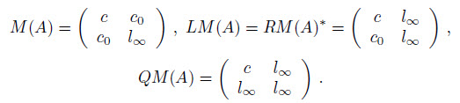
On multiplier modules of Hilbert C*-modules
Example

Slide 16

On multiplier modules of Hilbert C*-modules
Example (continued)
Consider A as a Hilbert A-module over itself in two ways:
<a,b>_{A} := a*b for a,b in A
<a,b>₁ := a*T*Tb = <T(a),T(b)>_{A} for a,b in A
One can calculate:

Slide 17
On multiplier modules of Hilbert C*-modules
Example
Then:
A = K_{A}(A) ≠ K_{A,1}(A) *-isomorphically as C*-algebras
M(A)= End_{A}*(A) ≠ End_{A,1}*(A) *-isomorphically as C*-
algebras
cf. [11].
Either M(A)=LM(A) and LM(A)=QM(A),
or M(A)  LM(A)  QM(A), cf. [8, Cor. 4.18].

Slide 18
Multiplier modules of Hilbert C*-modules

Slide 19
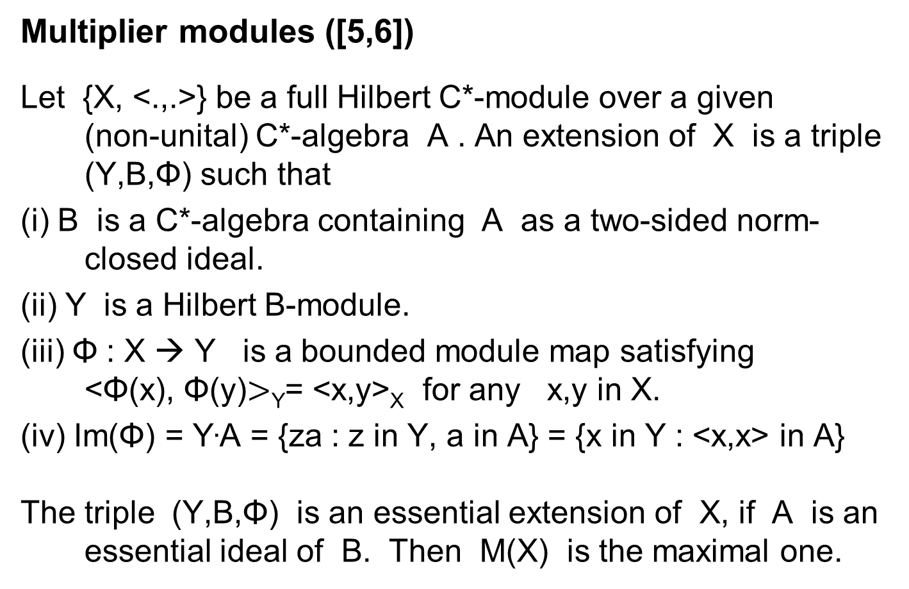
On multiplier modules of Hilbert C*-modules
Multiplier modules ([5,6])
Let {X, <.,.>} be a full Hilbert C*-module over a given
(non-unital) C*-algebra A . An extension of X is a triple (Y,B,Φ) such that
(i) B is a C*-algebra containing A as a two-sided norm-closed ideal.
(ii) Y is a Hilbert B-module.
(iii) Φ : X → Y is a bounded module map satisfying
<Φ(x), Φ(y)$>$_{Y}= <x,y>_{X} for any x,y in X.
(iv) Im(Φ) = Y.A = {za : z in Y, a in A} = {x in Y : <x,x> in A}
The triple (Y,B,Φ) is an essential extension of X, if A is an essential ideal of B. Then M(X) is the maximal one.

Slide 20
On multiplier modules of Hilbert C*-modules
Multiplier modules ([5,6])
Let {X,<.,.>} be a (not necessarily full) Hilbert C*-module over a given (non-unital) C*-algebra A. Denote by M(X) the set of all adjointable maps from A to X, i.e. M(X) := End_{A}*(A,X).
Obviously, M(X) is a Hilbert M(A)-module with the M(A)-valued inner product <z₁,z₂> = z₁*z₂ for z₁,z₂ in M(X). The resulting Hilbert M(A)-module norm coincides with the operator norm on M(X).
We call M(X) the multiplier module of X. It is a maximal extension of X, in case X is full. X = K_{A}(A,X).

Slide 21
On multiplier modules of Hilbert C*-modules
Multiplier modules [EchRae,Schw,D1,D2,BKMS,Del]
Let A,B be strongly Morita equivalent C*-algebras and X be an appropriate imprimitivity A-B bimodule.
A pair of maps (R,L) in End_{A}(A,X)End_{B}(B,X) such that
aL(b)= R(a)b, for any a in A, b in B,
is called a multiplier of X. The multiplier module M(X) of X is the set of all multipliers of X, a M(A)-M(B) Hilbert bimodule.
K_{A}(A,X) = K_{B}(B,X) = X  M(X) = End_{A}*(A,X) = End_{B}*(B,X)

Slide 22
On multiplier modules of Hilbert C*-modules
Theorem: [EchRae, Prop. A.1]
Let A be a C*-algebra and X be a full Hilbert A-module.
Then the multiplier module M(X) can be isometrically isomorphically identified with the right upper corner of the multiplier algebra M(L(X)) of the linking algebra L(X) .
However, the linking algebra L(M(X)) is smaller-equal to M(L(X)), generally speaking, and L(M(X)) might be non-unital.

Slide 23
On multiplier modules of Hilbert C*-modules
Pairings and their uniqueness
Proposition:
For a given pair of C*-algebras (A,M(A)) , let X₁, X₂ be two full Hilbert C*-modules over A such that their multiplier modules M(X₁), M(X₂) are isometrically isomorphic as Hilbert M(A)-modules. Then X₁ and X₂ are isometrically isomorphic as Hilbert A-modules to M(X₁)A = M(X₂)A resp..
So, the pairings (X,M(X)) are bound to each other for given C*-algebras (A,M(A)) up to unitary equivalence.

Slide 24
On multiplier modules of Hilbert C*-modules
Pairings and their uniqueness
Proposition:
Suppose, we have two non-isomorphic C*-algebras A₁ and A₂ such that they admit the same multiplier C*-algebra M(A) . Let X₁ be a full Hilbert A₁-module and X₂ a full Hilbert A₂-module such that M(X₁) and M(X₂) are unitarily isomorphic as Hilbert M(A)-modules.
Then X₁ is not unitarily isomorphic to X₂ as a Hilbert M(A)-module ( M(X₁)A₁=X₁ , M(X₂)A₂=X₂ ).

Slide 25
On multiplier modules of Hilbert C*-modules
Topological characterization
Let A be a C*-algebra and X be a Hilbert A-module. Let the strict topology on M(X) be induced jointly by the two families of semi-norms {z → za : a in A} and {||<z,x>|| : x in X, ||x||≤1} for z in M(X) . It is a locally convex topology.
The multiplier module M(X) turns out to be complete with respect to this strict topology, and M(X) is the strict completion of X , [5, Thm. 1.8, 1.9].
Moreover, the strict completion is an idempotent operation, i.e. M_{M(A)}(M_{A}(X)) = M_{A}(X).

Slide 26
On multiplier modules of Hilbert C*-modules
A Morita-like point of view
Theorem: cf. [EchRae, Prop. 1.3]
Let A be a C*-algebra and M(A) be its multiplier algebra. Let X be a full (right) Hilbert A-module and M(X) be its multiplier module, a full (right) Hilbert M(A)-module.
Then M(X) is also the full (left) multiplier module of the (left) Hilbert K_{A}(X)-module X with respect to the pairing of C*-algebras K_{A}(X) and M(K_{A}(X)) = End_{A}*(X) = M(K_{M(A)}(M(X))) = End_{M(A)}*(M(X)) , and vice versa.
There are non-unital, strongly Morita equivalent C*-algebras without multiplier imprimitivity bimodules.

Slide 27
On multiplier modules of Hilbert C*-modules
*-Isomorphism of key operator C*-algebras
[5, Thm. 2.3].
For X,Y Hilbert A-modules each operator T in End_{A}*(X,Y) has an extension T_{M} in End_{M(A)}*(M(X),M(Y)) with the same norm value obtained as the strict continuation of T . Therefore, it is uniquely determined.
Moreover, every operator in End_{M(A)}*(M(X),M(Y)) arises
this way, i.e. the C*-algebras End_{M(A)}*(M(X),M(Y))
and End_{A}*(X,Y) are *-isomorphic.
This covers also the non-full variant of the definition.

Slide 28
On multiplier modules of Hilbert C*-modules
"Compact" operator C*-algebras
Theorem:
Let A be a C*-algebra with multiplier algebra M(A) . Let X be a full Hilbert A-module and M(X) be its full multiplier module.
The C*-algebra K_{A}(X) of all "compact" operators on X admits a *-isomorphic embedding into the C*-algebra K_{M(A)}(M(X)) of all "compact" operators on M(X).
K_{A}(X) is smaller than K_{M(A)}(M(X)) if X ≠ M(X).

Slide 29
On multiplier modules of Hilbert C*-modules
Bounded module operator algebras
Theorem:
Let A be a C*-algebra with multiplier algebra M(A) . Let X be a full Hilbert A-module and M(X) be its full multiplier module.
There does not exist any bounded M(A)-linear map
T₀ : M(X) → M(X) such that T₀ ≠0 on M(X), but
T₀ = 0 on XM(X) .

Slide 30
On multiplier modules of Hilbert C*-modules
Bounded module operator algebras
Theorem (continued):
The Banach algebra End_{M(A)}(M(X)) admits an isometric embedding into the Banach algebra End_{A}(X) by restricting an element on the domain from M(X) to
X  M(X).
If the left multiplier algebra of K_{A}(X) is larger than the multiplier algebra of it, then End_{M(A)}(M(X)) can be smaller than End_{A}(X), i.e. not every bounded module operator might admit a bounded module operator continuation. (Existing continuations are unique.)

Slide 31
On multiplier modules of Hilbert C*-modules
Bounded module functionals
Theorem:
Let A be a C*-algebra with multiplier algebra M(A). Let X be a full Hilbert A-module and M(X) be its full multiplier module.
There does not exist any bounded M(A)-linear map
f₀ : M(X) → M(A) such that f₀≠0 on M(X), but f₀ = 0 on XM(X).
The Banach M(A)-module M(X)ʹ_{M(A)} admits an isometric modular embedding into the Banach A-module Xʹ_{A} by restricting an element on the domain from M(X) to
XM(X). There exist examples such that Xʹ_{A} is strictly larger than the embedded copy of M(X)ʹ_{M(A)}.

Slide 32
On multiplier modules of Hilbert C*-modules
Modular maps from X to Xʹ
Theorem:
The same suppositions …
There does not exist any bounded M(A)-linear map
T₀ : M(X) → M(X)ʹ such that T₀≠0 on M(X), but T₀=0 on XM(X).
The Banach space End_{M(A)}(M(X),M(X)ʹ) admits an isometric embedding into the Banach space End_{A}(X,Xʹ) by restricting an element on the domain from M(X) to XM(X) . There exist examples such that End_{A}(X,Xʹ) is strictly larger than the embedded copy of End_{M(A)}(M(X),M(X)ʹ) .

Slide 33
Q
Ideas and Questions

Slide 34
On multiplier modules of Hilbert C*-modules
Are multiplier modules C*-reflexive as Hilbert C*-modules? (it depends on the choice of A or M(A) ?)
Can certain C*-reflexive Hilbert C*-modules be characterized by intrinsic properties?
In general: XXʹʹXʹ , and all four pairs of inclusion relations appear in examples. Xʹʹʹ = Xʹ .
Are there (interesting) families of pairwise non-*-isomor-phic C*-algebras K_{A}(X) based on (parametrized) families of non-adjointable invertible bounded module operators T on X changing the C*-valued inner product on X ?

Slide 35
On multiplier modules of Hilbert C*-modules
Can two-sided norm-closed ideals A in M(A) and Hilbert A-modules X replaced by one-sided norm-closed ideals I in certain unital C*-algebras B to form „one-sided multiplier modules M(I)“ of them?
There exist first considerations by V. M. Manuilov, see arxiv.

Slide 36
Discussions …
Thank you for your attention.

Slide 37
References

Slide 38
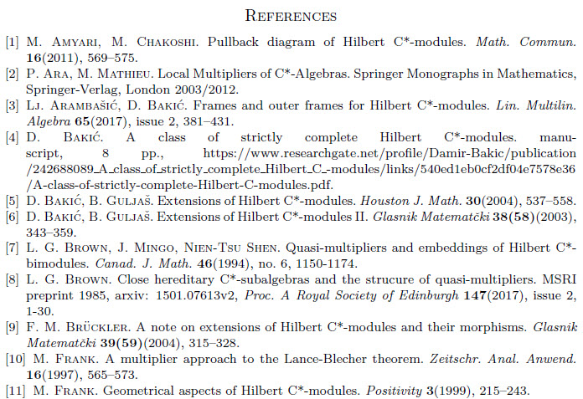
On multiplier modules of Hilbert C*-modules

Slide 39
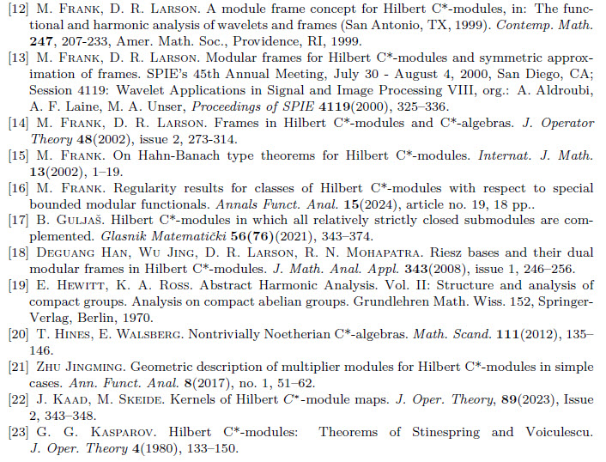
On multiplier modules of Hilbert C*-modules

Slide 40
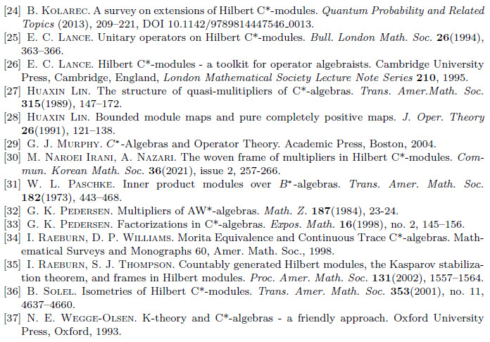
On multiplier modules of Hilbert C*-modules

Slide 41
On multiplier modules of Hilbert C*-modules
Recently found sources:
[D1] M. Daws, Multipliers, self-induced and dual Banach algebras. Dissertationes Math., 470:62(2010).
[D2] M. Daws, Multipliers of locally compact quantum groups via Hilbert C∗-modules. J. Lond. Math. Soc. (2) 84(2)(2011), 385-407.
[BKMS] A. Buss, B. Kwasniewski, A. McKee, A. Skalski, Fourier-Stieltjes category for twisted groupoid actions, www.arXiv.org 2405.15653 (2024). 76 pp..
[Del] A. Delfín (Ares de Parga), Representations of *-correspondences on pairs of Hilbert spaces, J. Operator Theory 92(2024), issue 1, 167-188. / www.arXiv.org 2208.14605v4.
[Lance] E. C. Lance, Unitary operators on Hilbert C*-modules, Bull. London Math. Soc. 26 (1994), 363-366.
[Blecher] D. P. Blecher, A new approach to Hilbert C*-modules, Math. Ann. 307(1997), 253-290.
[Frank] M. Frank, A multiplier approach to the Lance-Blecher theorem, ZAA 16 (1997), 565-573.
[Solel] B. Solel, Isometries of Hilbert C*-modules, Trans. AMS 353(2001), 4637-4660.
[EchRae] S. Echterhoff, I. Raeburn, Morita equivalence of crossed products, Math. Scand. 76(1995), 289-309.
[Schw] J. Schweizer, Hilbert C*-modules with a predual, J. Operator Theory 48(2002), 621-632.

Slide 42
Coda

Slide 43
Monotone complete C*-algebras:
C*-algebras for which each increasingly directed net
of positive elements admits a supremum inside the algebra.
Generally true in C*-algebras:
xy* = ¼ . _{k=1}⁴ i^{k} . (x+i^{k}y)(x+i^{k}y)* with i² = -1, x,y in A
Polarization identity.
For W*-algebras: There exists a w*-topology since they are dual Banach spaces. w*-completeness.

Slide 44
Order convergence of nets [M. Hamana, 1981, 1982]
A net {a_{α}: α in I} of elements of a monotone complete C*-algebra A converges in order to an element
a in A iff there are bounded nets {a_{α}^{(k)}: α in I} and {b_{α}^{(k)}: α in I} of self-adjoint elements of A and elements {a^{(k)} : α in I} in A with k=1,2,3,4 such that
(i) 0  a _{α}^{(k)} – a^{(k)}  b_{α}^{(k)} for any k, any α
(ii) {b_{α}^{(k)}: α in I} is decreasingly directed and has greatest lower bound zero
(iii) _{k=1}⁴ i^{k} a_{α}^{(k)} = a_{α} for every α in I, _{k=1}⁴ i^{k} a^{(k)} = a where i² = -1.
Independent of the choice of {a_{α}^{(k)}}, {b_{α}^{(k)}} , a^{(k)} .

Slide 45
Regularity results for classes of Hilbert C*-modules w.r.t. special bounded modular functionals
H – a Hilbert space, A – a σ-unital C*-algebra
A • H – the algebraic tensor product,
<a • h, b • g> = a <h,g>_{H} b*
(a,b in A, h,g in H) becomes a pre-Hilbert A-module, with norm-completion M = A  H.
A^{n}  A  C^{n} for any n in N.
l₂(A)  A  l₂, alternative description:
l₂(A) = { a={a_{i}}_{i in N} : Σ_{j=1} a_{j}a_{j}* converges w.r.t. ||.||_{A} }
with inner product <a,a> = Σ_{j=1} a_{j}a_{j}* .

Slide 46
Regularity results for classes of Hilbert C*-modules w.r.t. special bounded modular functionals
Theorem: (Kasparov, 1980) Stabilization Theorem
Every countably generated Hilbert A-module M over a σ-unital C*-algebra A possesses an embedding as an orthogonal summand of l₂(A) in such a way that the orthogonal complement is isometrically isomorphic to l₂(A) again, i.e. M  l₂(A) = l₂(A).
Theorem: (Serre-Swan, 1956, 1962; Kawamura, 2003)
Every algebraically finitely generated (Hilbert) C*-module M over a unital C*-algebra A is isomorphic to a (orthogonal) direct summand of a C*-module of type A^{n} for a finite number n , i.e. M  M^{c} = A^{n} .

Slide 47
Theorems: (Paschke, 1973; Hamana, 1992)
Let M be a Hilbert A-module over a W*-algebra (resp., monotone complete C*-algebra) A . Denote ist A-dual Banach A-module by Mʹ and its A-bidual Banach A-module by Mʹʹ .
Then the A-valued inner product continues from M to Mʹ embedding M  Mʹ  Mʹʹ and thus, stabilizing the extension process by A-duality.
Mʹ becomes a self-dual Hilbert A-module.
End_{A}(Mʹ) is W* (resp. monotone complete).

